Slide 1
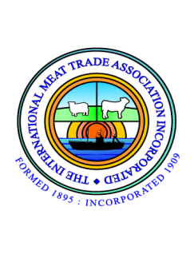
WTO Public Forum 2014
Is meat in danger of becoming a niche product in the EU?
Liz Murphy, Director
The International Meat Trade Association
www.imta-uk.org
info@imta-uk.org

Slide 2
EU-27 Per Capita Meat Consumption (2005 – 2013)

Slide 3
EU Meat Price Trends (2005 – 2013)

Slide 4
UK Retail Meat Prices
Product | Euros per kg
Rump steak | 16.25
Pork loin steak | 8.60
Lamb steak | 24.75
Chicken breast | 14.20

Slide 5
Why Could Meat be a Niche Product?
EU member state attitudes to science
Scope of EU legislation
Assurance Schemes
Changing global market for meat

Slide 6
Feeding the World
 | 1961 | 2011
Population (Billion) | 3.5 | 7
Cultivated land (Billion hectares) | 1.37 | 1.53

Slide 7
EU Approach to Science
Do we look at agriculture and science objectively?
Is the Precautionary Principle abused?
Do we encourage innovation?
The role of International standards

Slide 8
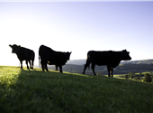
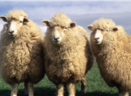
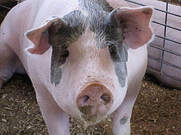
Scope of EU Legislation
Labelling – what is important?
Traceability and individual animal id

Slide 9
Assurance Schemes
“Buying Red Tractor fresh British lamb means buying a safe, assured, traceable product that helps maintain the iconic British landscape.

Slide 10
Assurance Schemes
“I believe it has a bright future, and we continue to see an increase in global demand for our superb product, but in order to have the confidence to invest in this future, farmers need to know that they have the backing of our domestic retailers……”

Slide 11
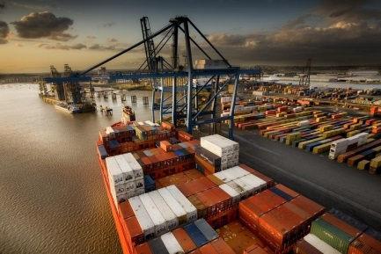
International Trade
EU production/exporters are hindered from taking advantage of increased global demand for meat.
EU importers find global suppliers less keen to ship to the EU.
Both in turn threaten a reduction in supplies on the EU market particularly for lamb and beef.
www.imta-uk.org

